Slide 1
Smart Traffic Management System for Urban Congestion
CSE7302- University Project
Review-2
Batch Number : CSE_14
Under the Supervision of,
Dr./Mr./Ms./Prof. Ms. Kummara Sruthi &
Ms. Tigulla Rajitha
Professor / Associate Professor / Assistant Professor
School of Computer Science and Engineering
Presidency University
20221CSE0234 | Syed Thousif
20221CSE0217 | Gujjula Ashok Vardhan Reddy
20221CSE0211 | Kambam Nithin Kumar Reddy
Roll Number | Student Name
Name of the Program : School of Computer Science & Engineering
Name of the HOD : Dr. Asif Mohammed
Name of the Program Project Coordinator : Dr.Jayavadivel Ravi , Mr. Muthuraju V
Name of the School Project Coordinators : Dr.Sampath A K , Dr. Geetha A

Slide 2
Problem Statement Number : SIH25050
Organization: Government of Odisha
Category (Hardware / Software / Both) : Software
Problem Statement Title : Smart Traffic Management System for Urban Congestion

Slide 3
Content
Abstract
Literature survey
Objectives
Drawbacks /Existing Methods
Proposed Method & Feasibility Study
Architecture Diagram
Modules
Hardware & Software Details

Slide 4
Abstract
Increasing traffic congestion and inefficient parking are major challenges in urban areas due to rapid vehicle growth.
Traditional traffic control systems are static and unable to handle real-time traffic conditions effectively.
The proposed Smart AI-Based Traffic and Parking Management System uses machine learning and computer vision technologies.
The system analyzes historical and live traffic data to predict congestion and optimize traffic flow.
Computer vision is used to detect available parking slots in real time.
Users can reserve parking spaces in advance, reducing unnecessary vehicle movement.
The system provides priority routing and signal optimization for emergency vehicles.
Overall, the proposed solution improves traffic efficiency, reduces congestion, enhances parking utilization, and supports smart city transportation initiatives.

Slide 5
Literature Survey
Author(s) & Year | Title | Methodology / Framework | Limitations / Gaps | Relevance to Our Project
Y. Kim et al. (2026) | Deep Learning–Based Adaptive Traffic Signal Control for Large-Scale Urban Networks | Deep learning–based adaptive signal control | High computational and training cost | Supports adaptive traffic signal optimization
S. Rahman et al. (2026) | Smart Traffic Congestion Prediction Using Artificial Intelligence and IoT | AI integrated with IoT sensor data | Strong dependency on sensor infrastructure | Aligns with real-time AI-based congestion prediction
M. Rajagopal et al. (2025) | Intelligent Transportation System for Traffic Flow Prediction Using GNN | Graph Neural Networks for traffic modeling | High computational complexity | Shows advanced prediction; our project uses simpler ML
Y. Huang et al. (2025) | Parking Availability Prediction Using Spatio-Temporal Transformer | Transformer-based spatio-temporal deep learning | Complex model, large data requirement | Supports smart parking availability prediction
C. Zhang et al. (2025) | Real-Time Traffic Flow Prediction Using Random Forest | Random Forest with sensor data fusion | Limited temporal dependency modeling | Closely related to our RF-based traffic prediction

Slide 6
Literature Survey
Author(s) & Year | Title | Methodology / Framework | Limitations / Gaps | Relevance to Our Project
S. Alam et al. (2025) | Multi-Source Data-Driven Traffic Congestion Detection Using AI | AI using multi-source urban data | Data integration complexity | Supports multi-source congestion analysis
R. Abduljabbar et al. (2024) | ML-Based Traffic Flow Prediction Models for Smart Cities | Comparative study of ML models | Focuses only on prediction | Helps in ML model selection
A. Rahmani et al. (2024) | AI-Enabled Intelligent Traffic Signal Management | ML-based smart traffic control | Limited emergency handling | Aligns with intelligent traffic control
T. Bouraffa et al. (2024) | Vision-Based Traffic Event Detection Using Deep Learning | CNN-based video analytics | High processing requirements | Useful for camera-based traffic monitoring
L. Falaschetti et al. (2024) | Embedded Real-Time Vehicle Detection for Traffic Control | Embedded deep learning (YOLO) | Hardware-dependent | Supports vehicle detection module

Slide 7
Literature Survey
Author(s) & Year | Title | Methodology / Framework | Limitations / Gaps | Relevance to Our Project
H. Li et al. (2023) | Graph Neural Networks in Intelligent Transportation Systems: A Survey | Survey of AI techniques in ITS | Mostly theoretical | Provides background for AI traffic systems
W. Wang et al. (2023) | Reinforcement Learning for Adaptive Traffic Signal Optimization | Reinforcement learning | Long training time | Supports adaptive signal timing logic
J. Chen et al. (2023) | Vehicle Prioritization Using Deep Learning | CNN-based vehicle prioritization | Parking not addressed | Relevant for emergency vehicle handling
A. Das et al. (2023) | Deep Learning-Based Traffic Anomaly Detection | DL-based anomaly detection | Requires large datasets | Useful for incident detection
Y. Lv et al. (2023) | Traffic Flow Prediction with Big Data | Deep learning on big traffic data | High training cost | Foundation for modern traffic prediction

Slide 8
Objectives
To ensure high camera quality for capturing clear and detailed visuals under different lighting and weather conditions.
To enable real-time (dynamic time) monitoring for instant detection, processing, and response to on-road situations.
To provide intelligent security alerts by automatically identifying suspicious activities or abnormal events.
To accurately detect and prioritize emergency vehicles (ambulance, fire engine, police) for faster response and traffic management.
To enhance public safety and emergency response efficiency through automated monitoring and alert mechanisms.

Slide 9
Drawbacks & Overcome
Drawbacks | Ways to Improve
Traffic predictions may not always be accurate during sudden events like accidents or roadblocks | Include live alerts from traffic police, GPS apps, and social media updates
Camera-based parking detection may fail in rain, fog, or poor lighting | Use better camera quality and combine camera data with sensor-based detection
Initial setup requires cameras, sensors, and network infrastructure | Start with small pilot areas and expand gradually
System performance depends on continuous internet availability | Use local processing (edge computing) for basic functions during network issues
Emergency vehicle detection may be delayed in very crowded traffic | Integrate GPS tracking for emergency vehicles for faster identification
Regularly retrain models using new and diverse traffic data | Machine learning models may need frequent updates to stay accurate

Slide 10
Proposed Method & Feasibility Study
Machine Learning–Based Traffic Prediction (Random Forest) Collects real-time and historical traffic data from cameras and sensors Splits data into multiple parts and builds many decision trees Each tree predicts traffic congestion independently Final prediction is based on the majority vote of all trees What We Achieve Early traffic congestion prediction for better route planning Adaptive traffic signal control in real time High accuracy with large traffic datasets Reduced travel time, fuel consumption, and congestion

Slide 11
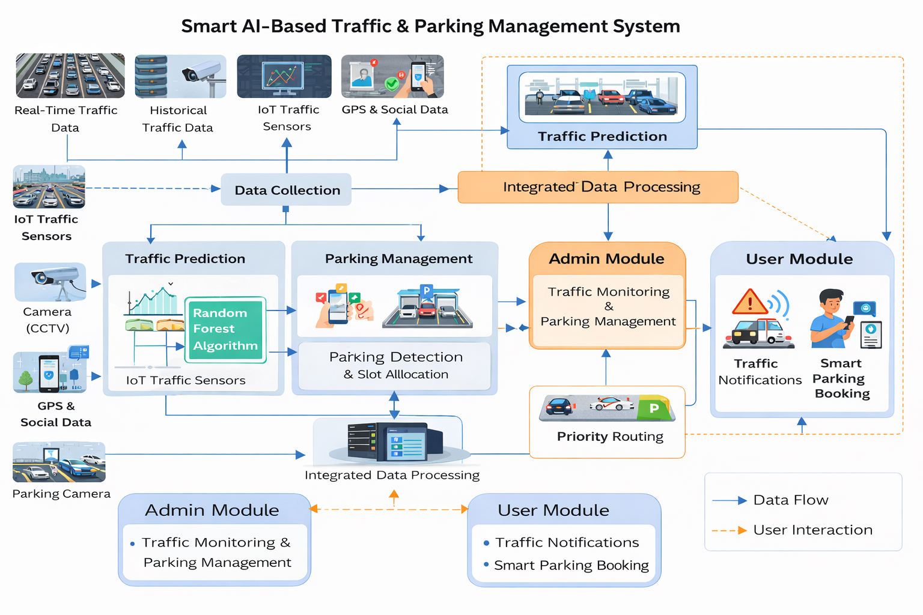
Architecture Diagram

Slide 12
Modules
Data Collection
Traffic Prediction
Parking Detection
Admin Module
User Module
Traffic Prediction
Parking Slot Detection
Route Recommendation
Traffic Signal Optimization
Admin & User Modules

Slide 13
Hardware & Software Details
Hardware Requirements
Processor: Intel i5 or above
RAM: 8 GB (16 GB recommended)
Storage: 256 GB SSD or higher
Camera: CCTV / Web Camera (for traffic & parking detection)
Internet connection (stable broadband)
Software Requirements
OS: Windows 10 / Linux
Programming: Python, HTML, CSS, JavaScript
Framework: Flask
Database: MySQL
Libraries: OpenCV, NumPy, Pandas, Scikit-learn
Tools: VS Code / Web Browser

Slide 14
References (IEEE Paper format)
[1] Y. Kim, H. Lee, and J. Park, “Deep learning–based adaptive traffic signal control for large-scale urban networks,” IEEE Access, 2026.
[2] S. Rahman and M. Hossain, “Smart traffic congestion prediction using artificial intelligence and IoT,” IEEE Open Journal of Intelligent Transportation Systems, 2026.
[3] M. Rajagopal, R. Sivasakthivel, and G. Anitha, “An intelligent transportation system for traffic flow prediction using graph neural networks,” IEEE Transactions on Intelligent Transportation Systems, 2025.
[4] Y. Huang, Y. Dong, Y. Tang, and L. Li, “Parking availability prediction via fusing multi-source data with a self-supervised learning enhanced spatio-temporal transformer,” IEEE Transactions on Intelligent Transportation Systems, 2025.
[5] C. Zhang, J. Wang, and Y. Liu, “Real-time traffic flow prediction using random forest and sensor data fusion,” IEEE Access, 2025.
[6] S. Alam, M. Luqman, and S. Ali, “Multi-source data-driven traffic congestion detection using artificial intelligence,” IEEE Access, 2025.
[7] R. Abduljabbar, H. Dia, and S. Liyanage, “Machine learning–based traffic flow prediction models for smart and sustainable traffic management,” IEEE Open Journal of Intelligent Transportation Systems, 2024.
[8] A. Rahmani, A. Al-Fuqaha, and M. Guizani, “AI-enabled intelligent traffic signal management for smart cities,” IEEE Access, 2024.

Slide 15
References (IEEE Paper format)
[9] T. Bouraffa, E. Wessman, and A. Nouri, “Vision-based traffic event detection using deep learning,” in Proc. IEEE International Conference on Intelligent Transportation Systems (ITSC), 2024.
[10] L. Falaschetti et al., “Embedded real-time vehicle detection for intelligent traffic control systems,” IEEE Transactions on Intelligent Transportation Systems, 2024.
[11] H. Li, X. Pang, and Z. Chen, “Graph neural networks in intelligent transportation systems: A survey,” IEEE Transactions on Intelligent Transportation Systems, 2023.
[12] W. Wang, R. Patel, and S. Rao, “Reinforcement learning for adaptive traffic signal optimization,” IEEE Intelligent Systems, 2023.
[13] J. Chen, X. Li, and W. Zhang, “Vehicle prioritization using deep learning for real-time traffic signals,” IEEE Transactions on Intelligent Transportation Systems, 2023.
[14] A. Das, S. Roy, and P. Kumar, “Deep learning–based traffic anomaly detection for intelligent transportation systems,” in Proc. IEEE International Conference on Machine Learning and Applications (ICMLA), 2023.
[15] Y. Lv, Y. Duan, W. Kang, Z. Li, and F.-Y. Wang, “Traffic flow prediction with big data: A deep learning approach,” IEEE Transactions on Intelligent Transportation Systems, 2023.

Slide 16


